Slide 1
FUNCTIONAL ENGLISH SS1012
COURSE IN-CHARGE: MS. WAJIHA AKBER
wajiha.akber@nu.edu.pk

Slide 2
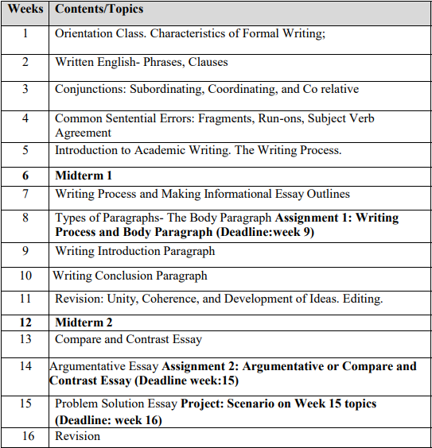

Slide 3
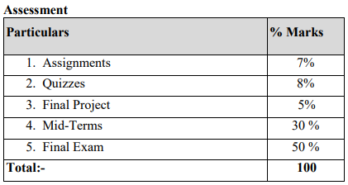

Slide 4

UNDERSTANDING THE FEATURES OF FORMAL WRITING

Slide 5
Key Features:
Well-Planned
Syntactic Complexity
Standard Grammar
Formal Vocabulary
Well-Organized
Use of Punctuations
Delayed Feedback
No Short Forms
Impersonal Language
Learnt Craft

Slide 6
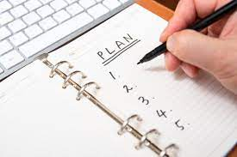
1) Well-Planned:
Not spontaneous like regular conversations.
follow the writing process
planned, composed, revised, and edited before it is recaches the audience.

Slide 7
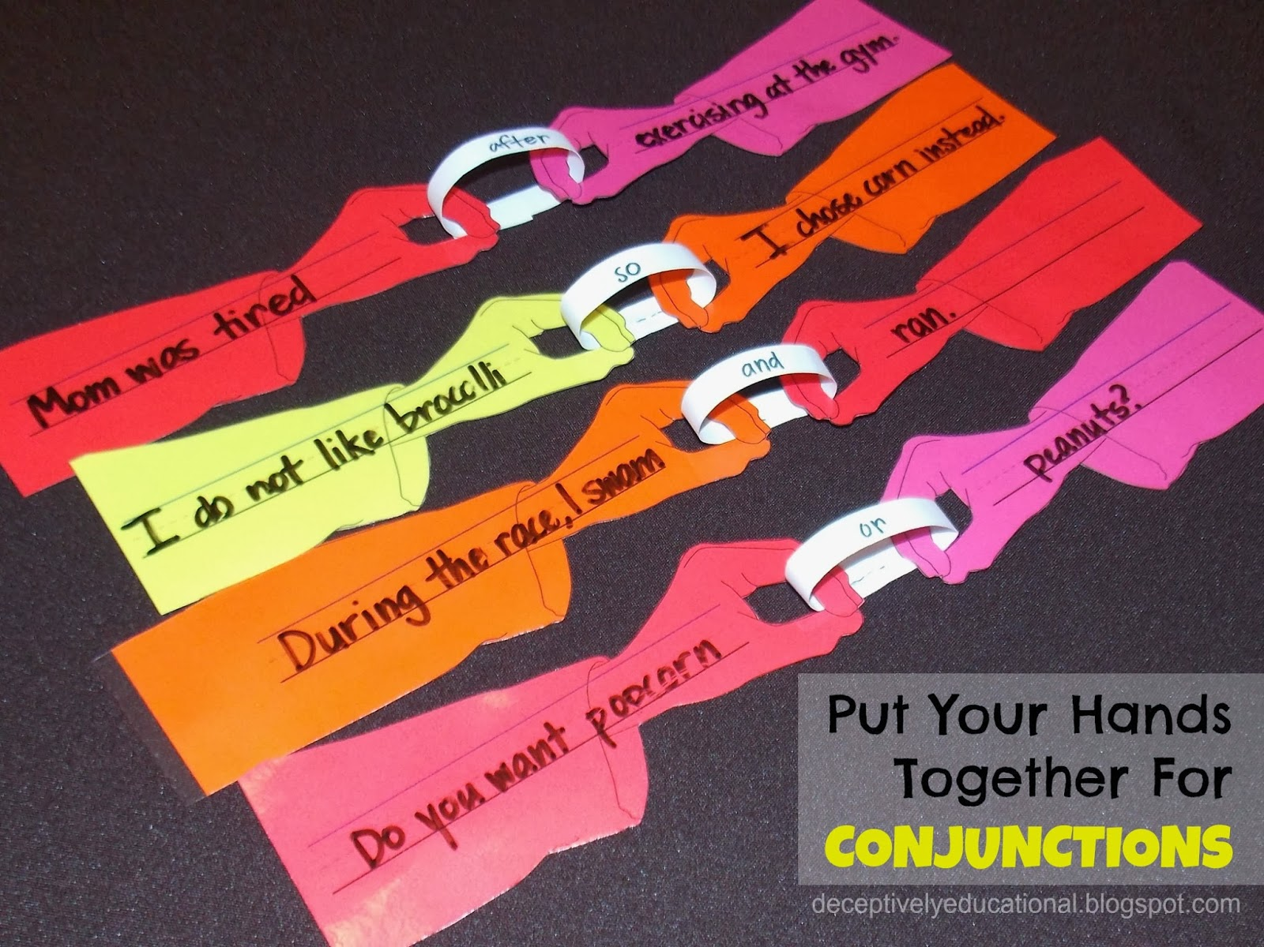
2) Syntactic Complexity:
- well-formed and refined sentences.
- Connectors and conjunctions are important to make writing compact and not repetitive.
Connectors

Slide 8
3) Standard Grammar:
- Follow grammar rules strictly.
- Any grammatical mistake can lead to misunderstanding.
My sister adopted another cat named Ghost.
(So she has two cats named Ghost now?)
Here is a correct version of this sentence:
My sister adopted another cat and named her Ghost.

Slide 9
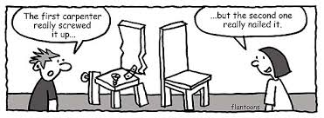
4) Formal Vocabulary:
Uses dignified vocabulary.
It avoids the usage of idioms and phrasal verbs

Slide 10

5) Well Organized:
- written message must be well-structured and organized.
-well- formed sentences & paragraphs.
- format of written document (letter, essay, etc.) must be followed for clarity

Slide 11
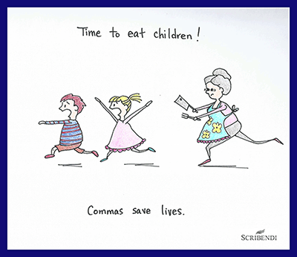
6) Use of Punctuations:
- Speakers use their voices (pitch, rhythm, stress), pauses, intonation and their bodies to communicate their message
- Punctuation marks, underlining, capitals, and connectors can be used to represent pauses, emphasis, tone, etc.
Punctuation

Slide 12

7) Delayed Feedback:
- In spoken language, immediate feedback in the form of verbal (questions, comments, grunts) and non- verbal tools (facial expressions, body language).
-Writer may have to anticipate the reader’s feedback and incorporate it into the text.

Slide 13
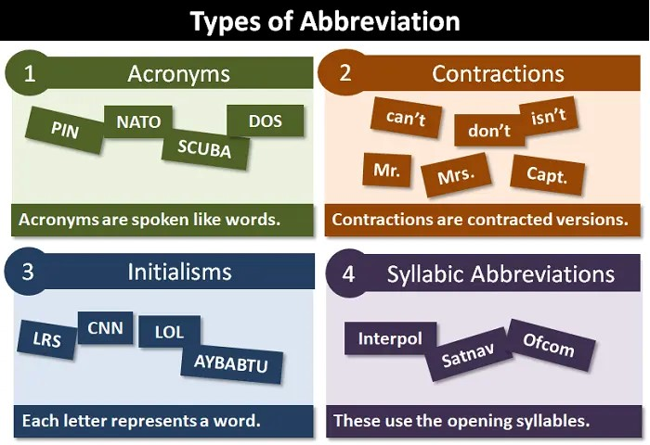
8) No contractions:
- It avoids abbreviations and short forms.
- It uses formal and well-known acronyms or abbreviation usually after using the full form first and then informing the reader that the writer will use the short form in the future.

Slide 14
9) Impersonal Language:
10) Learnt Craft:
- Avoid the use of personal pronouns such as “I”, “we” and even “you”.
Formal writing is a learnt skill and essential for both academic and professional success.

Slide 15
Exercise #1: Re-write the sentences by making them impersonal
1) We should invest more money in education.
2) If we banned the use of petrol as a fuel for cars, and we encouraged people to buy electric cars, this would help protect the environment.
3) I cannot understand why this decision was taken.
4) We expect the train strike will begin tomorrow
5) My experiment proves the hypothesis.
6) I think that the minister will resign.
7) I suggest that the new model must be tried.
8) We should learn more languages as it improves our decision making skills.

Slide 16
Exercise #2: Re-write the sentences using full forms
1) He can't guarantee that the defendant will appear because the defendant hasn't called him in several days.
2) It's a long way from Tipperary.
3) They’re coming into town tomorrow.
4) The outcomes of the study haven’t been documented yet.
5) I discovered that I didn't tremble anymore when I had to speak publicly.
6) The character isn't aware that he's surrounded by people he can't trust.
7) Two-thirds of the eighth grade students can’t read at grade level.

Slide 17
Here's a paragraph that uses personal pronouns and contractions. Rewrite the paragraph to eliminate these elements:
"Hey there! I wanted to tell you about this awesome new app I've found. It's called 'DiscoverEZ,' and it's all about making your life easier. You can download it on your phone and it'll help you with everything, from managing your schedule to keeping track of your tasks. It even sends you reminders so you don't forget important stuff. I've been using it for a week now, and I can't imagine going back to my old ways. I'm sure you'll love it too once you give it a try!"

